Slide 1
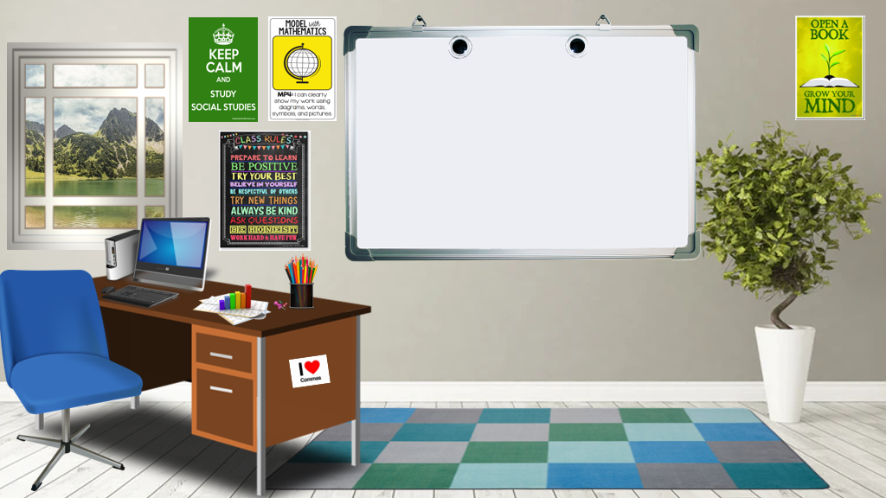
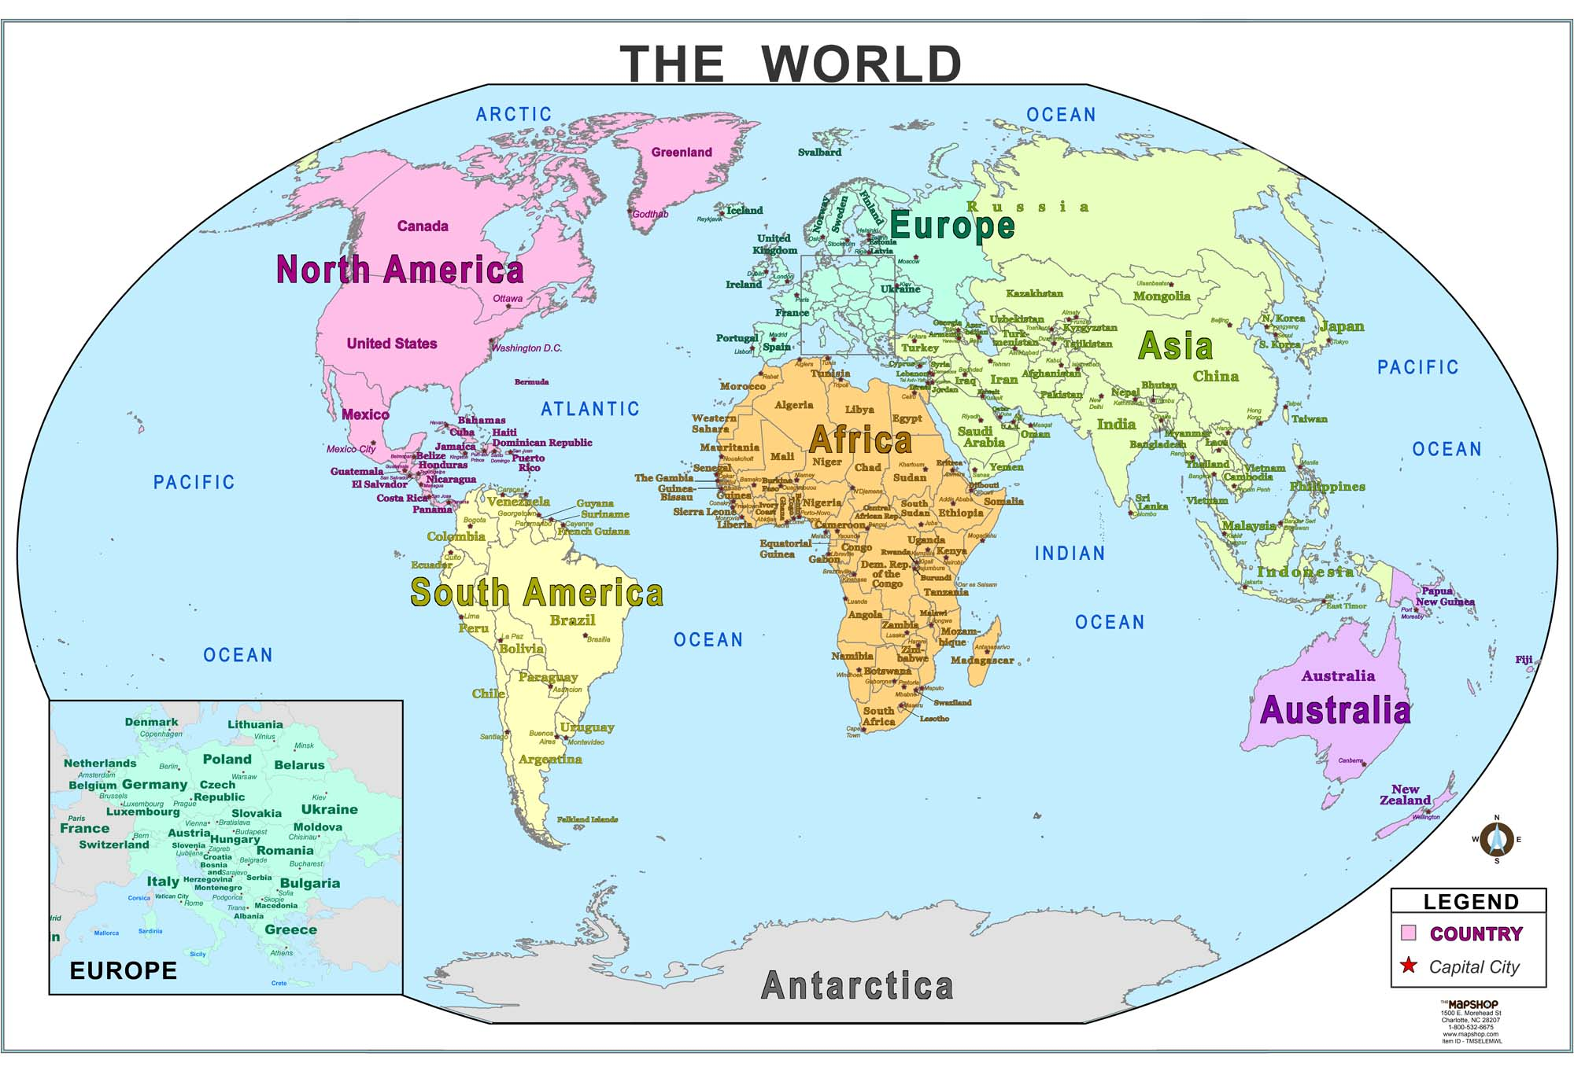
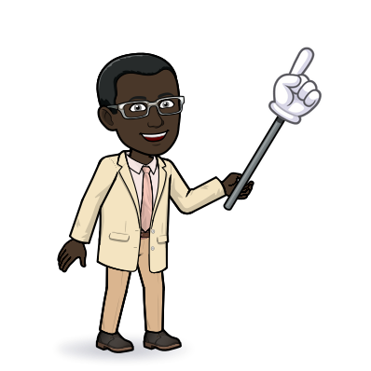
Welcome to 6th Grade Individuals and Society with Mr. Segure!
dsegure@hempsteadschools.org
We meet on:
Find our work on:

